Slide 1
How SSUSI and GUVI Work
Larry J. Paxton
GUVI co-PI
SSUSI PI
SSUSI/GUVI Team

Slide 2
FUV Spectral Region Exhibits the Signatures of Space Weather in the Upper Atmosphere
FUV spectral features were identified and interpreted during 30 years of rocket and spacecraft missions.
The table indicates the known processes that can be identified and characterized by their FUV (120 to 180 nm) spectral signatures.
  Your eye sees between 400 and 700nm.
Some of these parameters are being used to create higher level data products –such as climatologies of auroral inputs
 | HI (121.6 nm) | OI (130.4 nm) | OI (135.6 nm) | N₂ (LBHs) | N₂ (LBHl)
Dayside Limb | H profiles and escape rate¹ | Amount of O₂ absorption¹ | altitude profile O+ topside | Amount of O₂ as seen in absorption | N₂, Temperature
Dayside Disk | Column H | Amount of O₂ absorption¹ | Used with LBHs to form O/N₂ | N₂, Solar EUV | Solar EUV
Nightside Limb | H profile and escape rate | Ion/ENA precipitation | EDP HmF2 NmF2 T_{plasma} | Ion/ENA precipitation characteristic energy | Ion/ENA precipitation characteristic energy
Nightside Disk | Geocorna and Ion/ENA precipitation | Ion/ENA precipitation | ∫n_{e}²ds (line of sight) and ∫n_{e}dz (vertical TEC) Ion/ENA precipitation | Ion/ENA precipitation | Ion/ENA precipitation
Auroral Zone | Region of proton precipitation | Auroral Boundary and amount of column O₂ present¹ | Region of electron and (possibly) proton precipitation | Used with LBHl to form Eo and the ionization rate and conductance information | Measure of the effective precipitating flux, used with LBHl to form Eo and the ionization rate and conductance information

Slide 3
FUV Spectral Region Exhibits the Signatures of Space Weather in the Upper Atmosphere
Some of the more important are
  Auroral information
  Ionosphere electron density profiles
  Neutral composition
 | HI (121.6 nm) | OI (130.4 nm) | OI (135.6 nm) | N₂ (LBHs) | N₂ (LBHl)
Dayside Limb | H profiles and escape rate¹ | Amount of O₂ absorption¹ | altitude profile O+ topside | Amount of O₂ as seen in absorption | N₂, Temperature
Dayside Disk | Column H | Amount of O₂ absorption¹ | Used with LBHs to form O/N₂ | N₂, Solar EUV | Solar EUV
Nightside Limb | H profile and escape rate | Ion/ENA precipitation | EDP HmF2 NmF2 T_{plasma} | Ion/ENA precipitation characteristic energy | Ion/ENA precipitation characteristic energy
Nightside Disk | Geocorna and Ion/ENA precipitation | Ion/ENA precipitation | ∫n_{e}²ds (line of sight) and ∫n_{e}dz (vertical TEC) Ion/ENA precipitation | Ion/ENA precipitation | Ion/ENA precipitation
Auroral Zone | Region of proton precipitation | Auroral Boundary and amount of column O₂ present¹ | Region of electron and (possibly) proton precipitation | Used with LBHl to form Eo and the ionization rate and conductance information | Measure of the effective precipitating flux, used with LBHl to form Eo and the ionization rate and conductance information

Slide 4
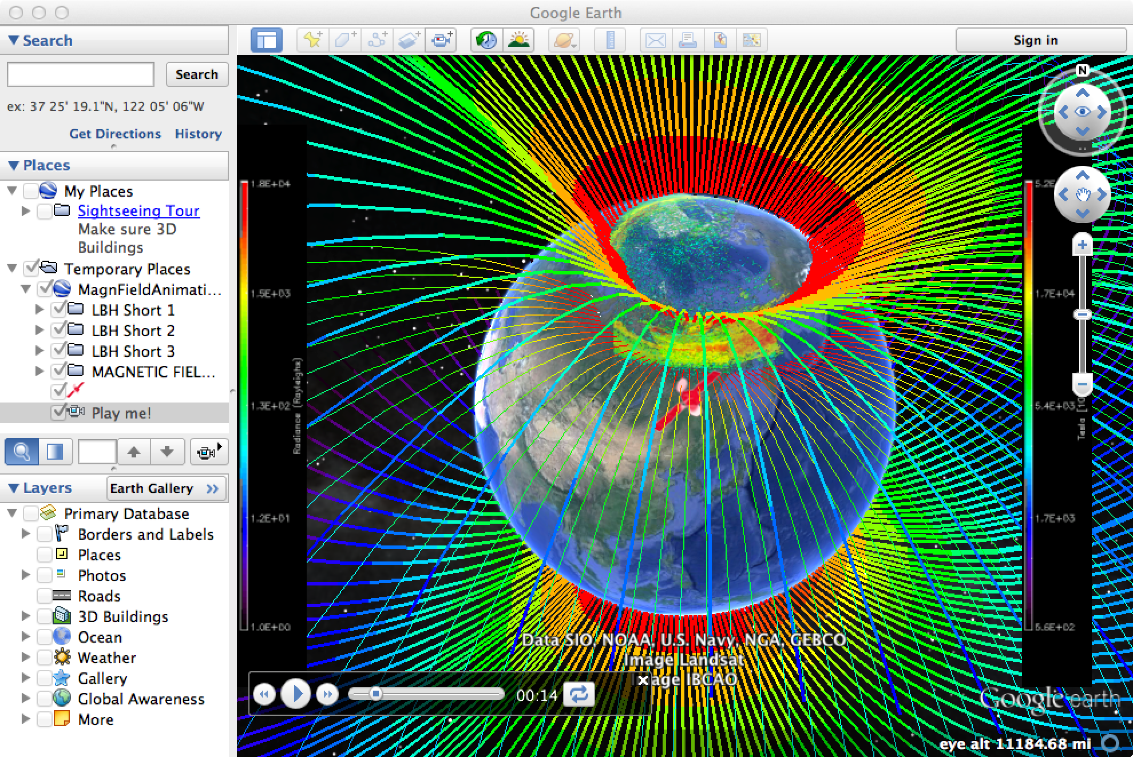
SSUSI Provides GUVI Imaging Capability and More!
In 1990, SSUSI started out as an experiment on DMSP Block 5D3. After development of the space weather mission, SSUSI was considered to be on the path to operational use.
Over time, the sensor role changed from an instrument that took auroral images to a scientific instrument capable of providing
  Auroral images
  Auroral energy inputs
  Auroral ionospheric products
  Ionospheric images
  Ionospheric bubble maps
  Neutral atmosphere composition
  High energy particle precip. maps
  Magnetic field maps for s/c charging
  And providing input to operational models
We continue to develop new products

Slide 5
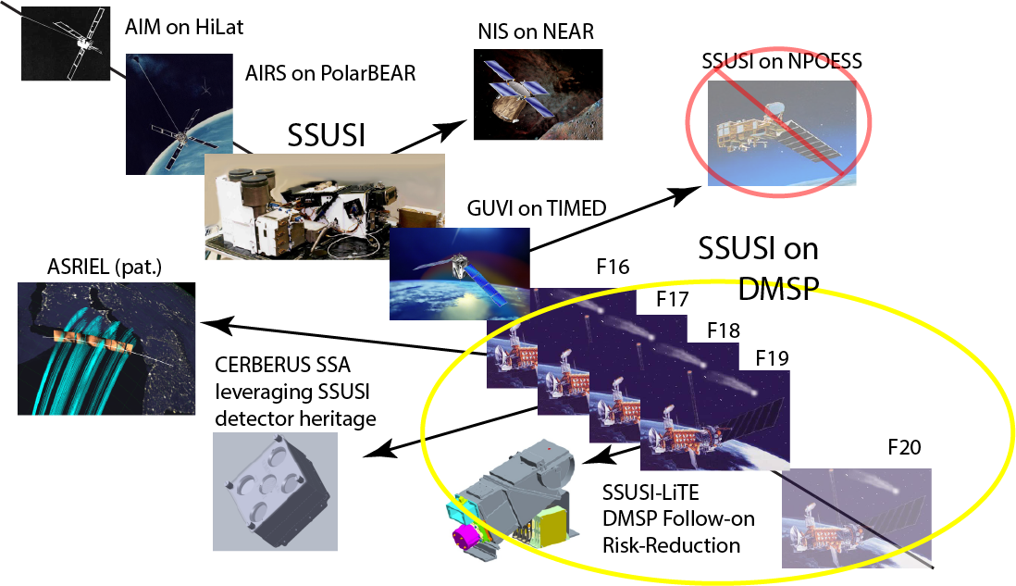
SSUSI Heritage and Relationship to Other Programs

Slide 6
SSUSI
Special Sensor Ultraviolet Spectrographic Imager
SSUSI was designed to fly on the USAF Defense Meteorological Satellite Program (DMSP) Flights F16 – F20
The SSUSI program began in January 1990
Five SSUSI instruments were designed, fabricated, tested and delivered from 1990 to 1997
Four SSUSI instruments are now on-orbit
  F16 was launched 18 October 2003 – now at 16.23UT (limb adds 1.5 hr in LST offset)
  F17 was launched 4 November 2006 – now at 17.43
  F18 was launched 18 October 2009 – now at 19.25
  F19 was launched 3 April 2014 – now at 17.40
  F20 will launch somewhere between April 2016 and … 2020?
Limb adds 1.5 hr in LST offset – get 3D information!

Slide 7
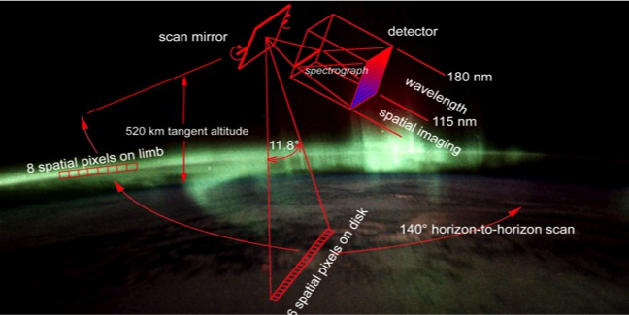
SSUSI is a mechanically scanned, cross-track, spectrographic imager
Key idea: Optimize options for providing Space Weather data and predictions to the warfighter

Slide 8
SSUSI-Lite has the ability to vary the scan pattern and adapt to different LST orbits and altitudes as well as mounting orientations.
Key idea: Optimize options for providing Space Weather data and predictions to the warfighter
Tangent altitude can be varied for different applications.
Same number of pixels on limb as disk
Maintain this capability but feet on housing allow scan range to be tilted fore or aft and to one side or the other

Slide 9
SSUSI Imaging Mode
The SSUSI scan pattern observes both the Earth limb and disk
24 cross track limb pixels at 0.4° per pixel
180 cross track by 16 along track pixel image is generated at 5 UV colors
Consecutive image scans are contiguous at nadir
156 cross track disk pixels at 0.8° per pixel

Slide 10
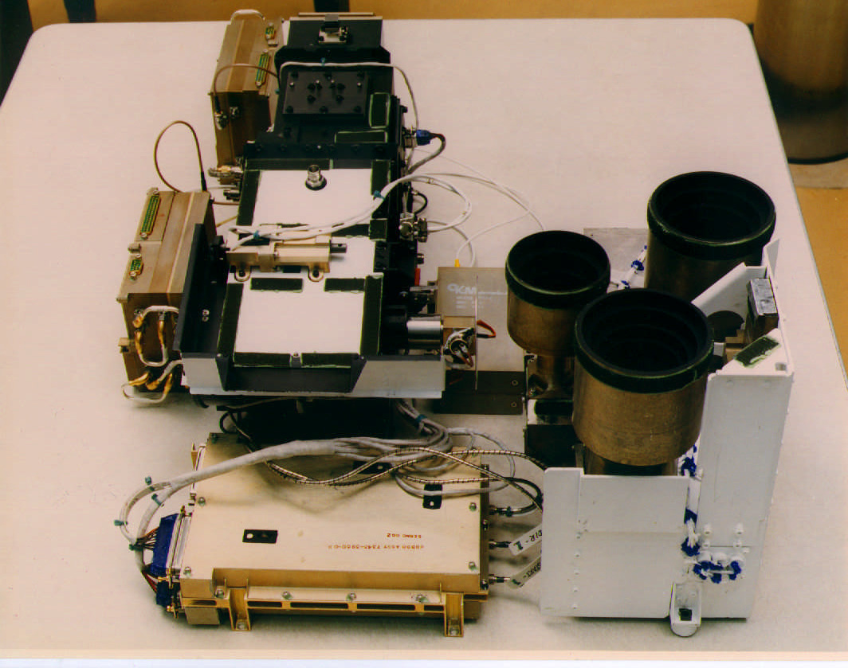
SSUSI has Three Major Components
SSUSI consists of three subsystems:
  Scanning Imaging Spectrograph (SIS)
  Nadir Photometer Subsystem (NPS)
  Support Module
The Scanning Imaging Spectrograph generates horizon-to-horizon images at five UV colors by using a cross track scan mirror. The SIS contains redundant detectors, HVPS, and focal plane electronics.
The Nadir Photometer Subsystem includes three nadir-viewing photometers at 427.8 nm, 629 nm, and 630 nm.
The Support Module contains the SSUSI processors, control and interface circuitry, and power converters. The Support Module is located on DMSP panel 5.
Scanning Imaging Spectrograph
Number of packages was driven by desire to procure and build the system quickly rather than packaging
Photometer

Slide 11
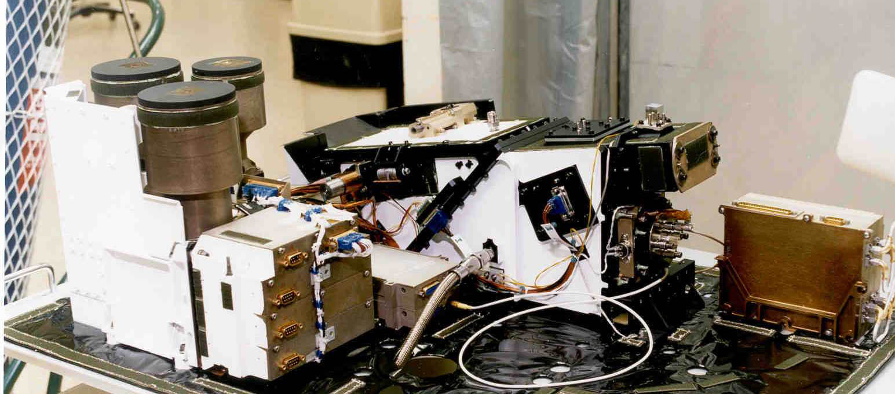
The SSUSI Program Provides New Capabilities to the DoD
630 and 629 nm Photometers
428 nm Photometer
Hyperspectral Imager – the Scanning Imaging Spectrograph (SIS)
Notes:
The SIS is about one foot long and 11 inches high – had to fit under the GLOB

Slide 12
The SSUSI Program Provides New Capabilities to the DoD
630 and 629 nm Photometers
428 nm Photometer
Hyperspectral Imager – the Scanning Imaging Spectrograph (SIS)
The “big picture” as well as altitude profiles
Ionospheric and auroral diagnostics
only directly below the s/c
Notes:
The SIS is about one foot long and 11 inches high – had to fit under the GLOB

Slide 13
SSUSI Functional Block Diagram
3 Slits, 2 Detectors and Photometers = COMPLEX!

Slide 14
SSUSI: Details of the Scanning Imaging Spectrograph
The SIS subsystem is a far-ultraviolet scanning imaging spectrograph
Measures the Earth’s far-UV airglow on a global basis
Generates 5 simultaneous monochromatic images
Performs a cross track line scan with an overscan onto the limb
Spectral range is 115 to 180 nm
Field of regard is 134.4° cross track by 11.8° along track
Scan period is 22 seconds
Includes redundant detectors, focal plane electronics, and high voltage power supplies

Slide 15
Flowdown of Requirements is Driven by Products

Slide 16
SSUSI “Color” Definitions Reduces Support Requirements
SSUSI produces monochromatic multispectral images by extracting “colors” from the observed spectrum.
The SSUSI “colors” reduce data rate while preserving the information required to produce EDRs.
The highlighted areas indicate the wavelength regions for the five SSUSI colors. The two curves show how the colors reflect changes in the characteristic energy and flux of the incoming particles.

Slide 17
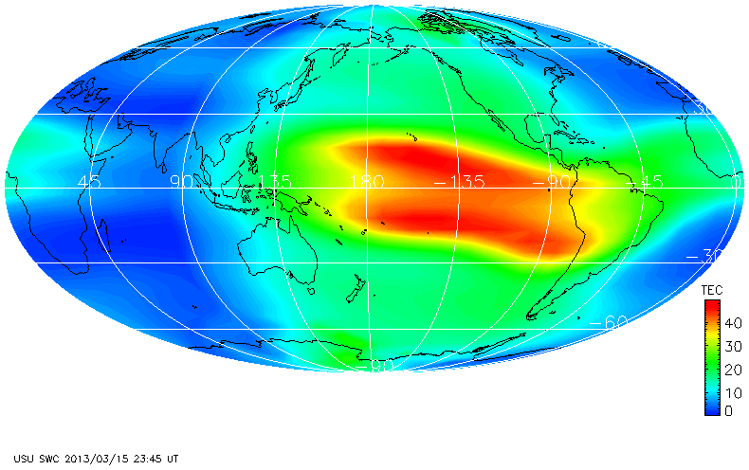
GAIM Provides a Global View at all Local Times
Pixel sizes:
Instrument - 10 km x 10 km
SDR - 25 km x 50 km
EDR - 100 km x 200 km
GAIM - 300 km x 600 km

Slide 18
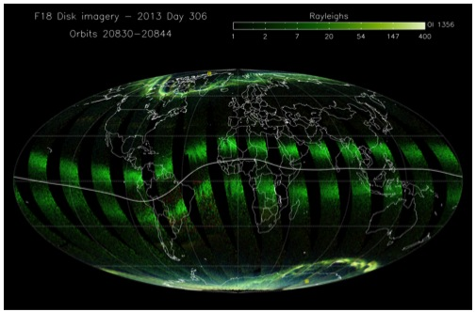
SSUSI Provides a Local View, Globally, at one Local Time
Typical SSUSI image – more available on http://ssusi-dev,jhuapl.edu
Bubbles – regions where the ionosphere is distorted in 3D (2 examples shown)
Individual swaths – one per orbit

Slide 19
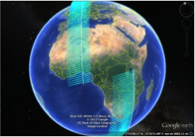
SSUSI Data Products Reflect Operational Use of SSUSI Data
SSUSI and SSUSI-Lite provide a fine-scale view of the ionosphere
Current scan pattern is fine for smoothing data and providing input for a global model
Inherent capability exists to use 3D information from scans

Slide 20
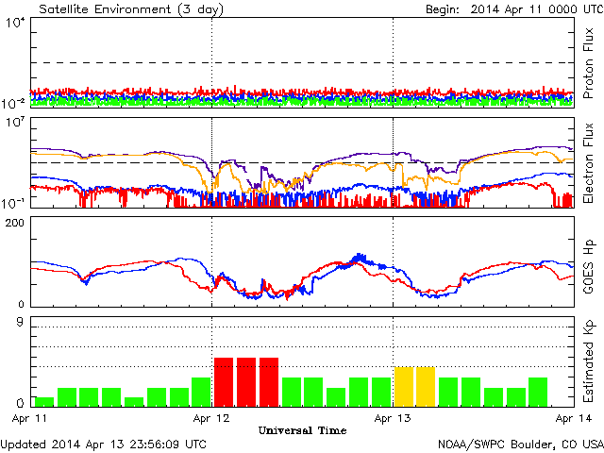

Slide 21
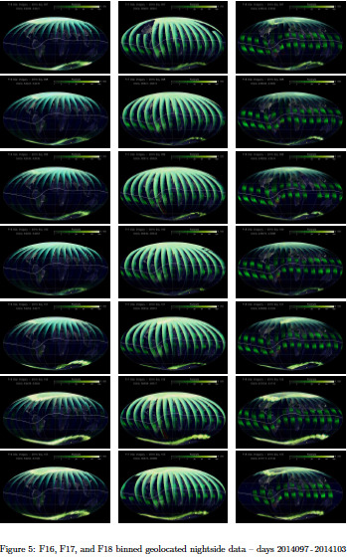

Slide 22
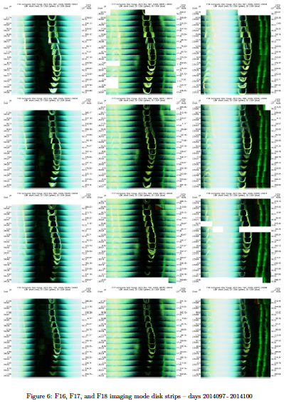

Slide 23
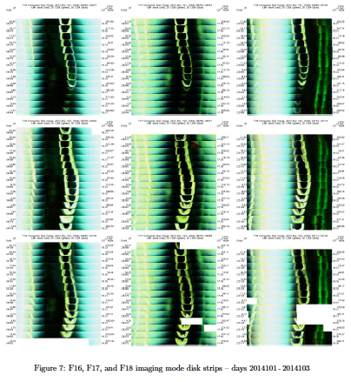

Slide 24
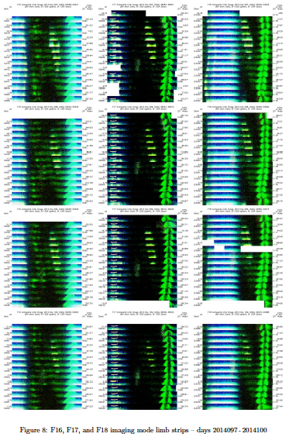

Slide 25
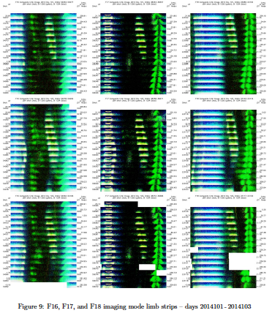

Slide 26
SSUSI Flight Sensors Varied in Response to Observed Performance on Orbit
Flight | F16 | F17 | F18 | F19 / F20
Serial No. | 05 | 03 | 04 | 01 / 02
SIS Grating | Hyperfine Ruled | SSUSI blazed holographic | GUVI unblazed holographic | Hyperfine Ruled
Sun Sensor | Included | Removed | Removed | Removed
Detector #1 | SAIC | Photek | Photek | Photek (new feedthru)
Detector #2 | SAIC | SAIC | SAIC (with mask) | Photek (new feedthru)
SIS Aperture | 250 mm² | 500 mm² | 500 mm² | 500 mm²
Operational Slit | Narrow | Wide | Wide | Medium
NPS Threshold | Low | 2X | 2X | 2X
Unit serial numbers defined in order of original SSUSI deliveries in the 1990’s.
SN05 selected for first flight based on having SAIC detectors with lowest red leak.

Slide 27
SSUSI Data are Available
Remember: this is web site is not supported by NASA, NSF or the Air Force for science use
  We do want suggestions
  We can incorporate new products
The SSUSI instruments are complicated and reach back 25 years
The SSUSI orbits are near the terminator and, consequently, yield data that are both useful and complex.
Involve the team in data analysis efforts and papers.

Slide 28
Use Case for SSUSI with GPS RO

Slide 29
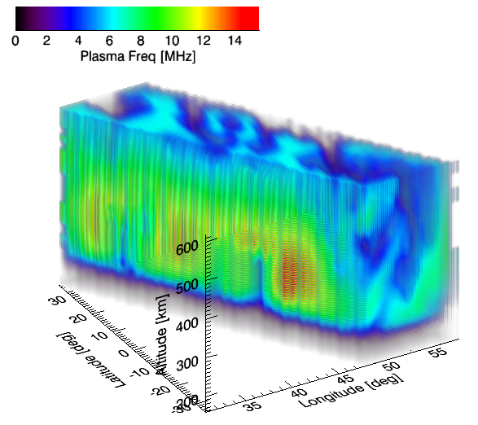
SSUSI Data Cubes and GPS RO
The community generally accepts the “truthiness” of GPS RO
  Also provides a measure of scintillation that can now be geolocated (can’t do this without SSUSI-Lite imagery or lots of assumptions).
  Note that GPS RO only provides information on scintillation at GPS wavelengths.
Correlation with structures and evolution of features should provide us with better, actionable information about scintillation at other wavelengths.
  3D imagery can predict the occurrence of scintillating regions.
    Use of tilts to indicate motions
    Bottomside structure to perform propagation analysis
s/c

Slide 30
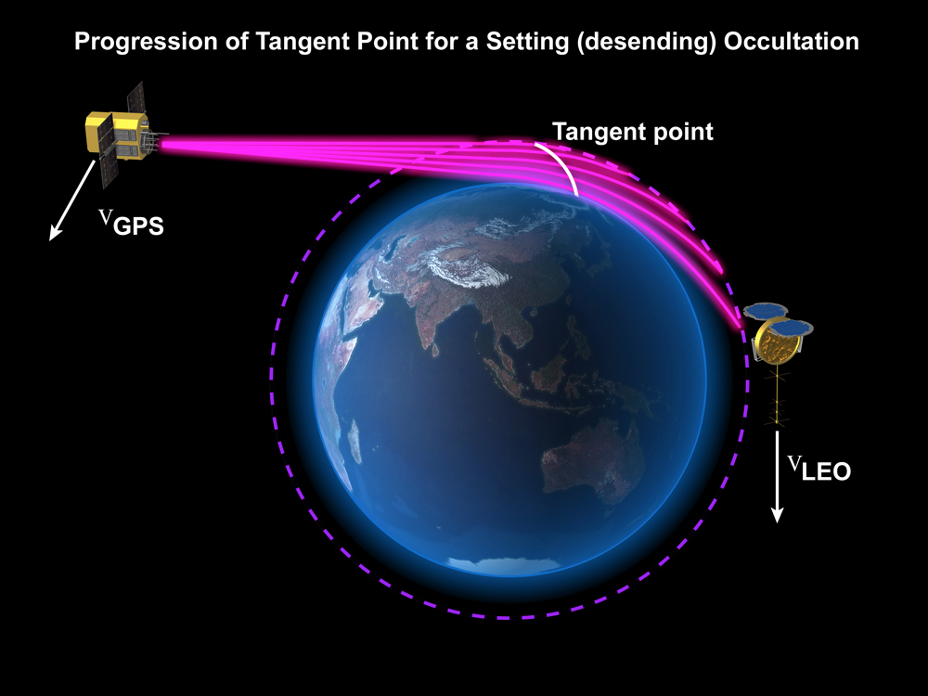
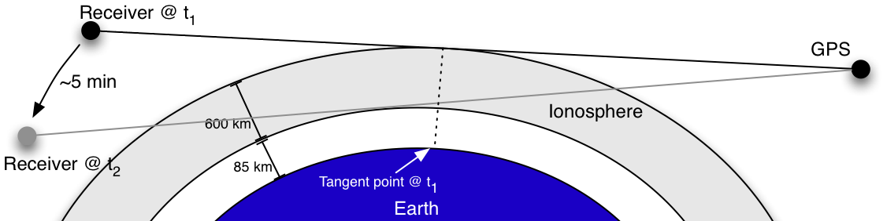
GPS RO is Cheap and Useful in Unstructured Ionosphere
GPS radio occultation (RO) techniques allow derivation of atmospheric properties from GPS signals measured from receivers: looking at phase delays in two different GPS frequencies
Measurements made as GPS satellite is setting or rising relative to the receiver
Conceptual illustration of GPS ionospheric occultation
Analysis done by Nishant Metha

Slide 31
GPS RO Profiles are Complex – They Just Look Simple
A major assumption: atmospheric layers are essentially homogenous over the path length of the signal
  Therefore, path lengths (and horizontal resolution) can be as much as 5000 km, depending on the tangent altitude
  The contribution function typically peaks in a region about 1600 km long for typical ionospheric altitudes and scale height.
Measurements are made assuming that it is valid at the tangent point: the point along the signal path that is closest to the Earth
  Plots of “GPS RO coverage” are always shown as points
Soundings are generally considered as vertical profiles at some tangent point
However, tangent point can move significantly over measurement period: on average about 5 minutes for ionosphere soundings (from 85 to 600 km altitude), although can be as large as an hour

Slide 32
Effect of Receiver/GPS Inclination
Receiver/GPS source inclination affects tangent point movement during occultation
We did a study to assess tangent point geometry for one receiver and one GPS satellite, as a function of inclination difference
Example: satellite in LEO and GPS 2R-14 on 20 September 2009
  GPS at ~55° inclination
  Vary inclination of receiver from 55° to 145°

Slide 33
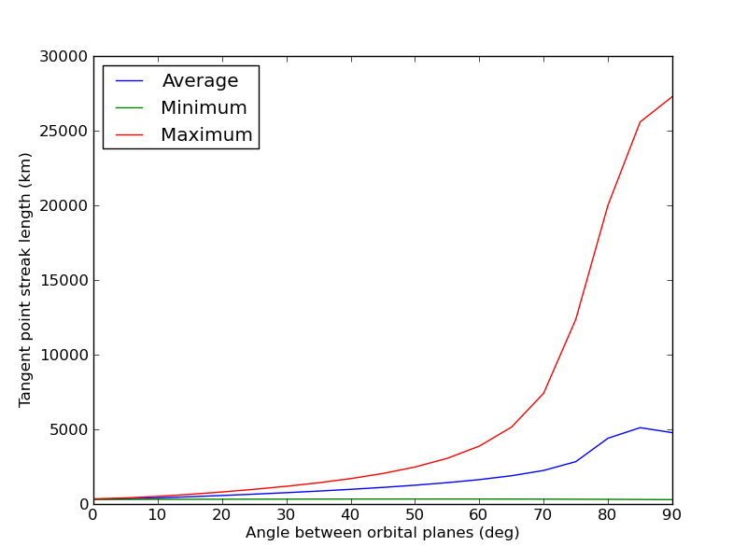
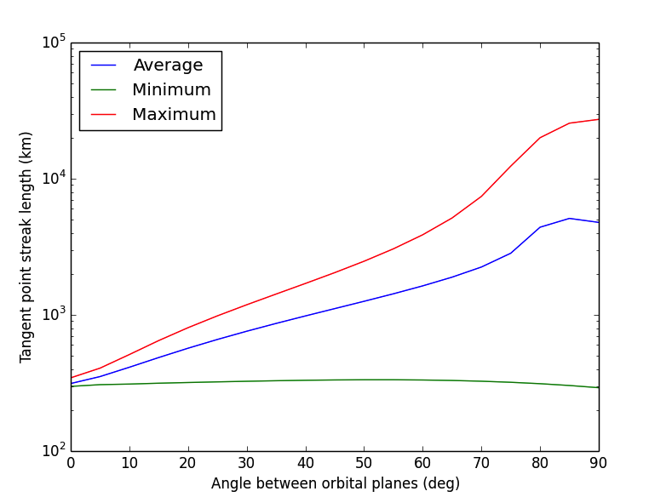
Number of useful occultations is constrained by inclination offset

Slide 34
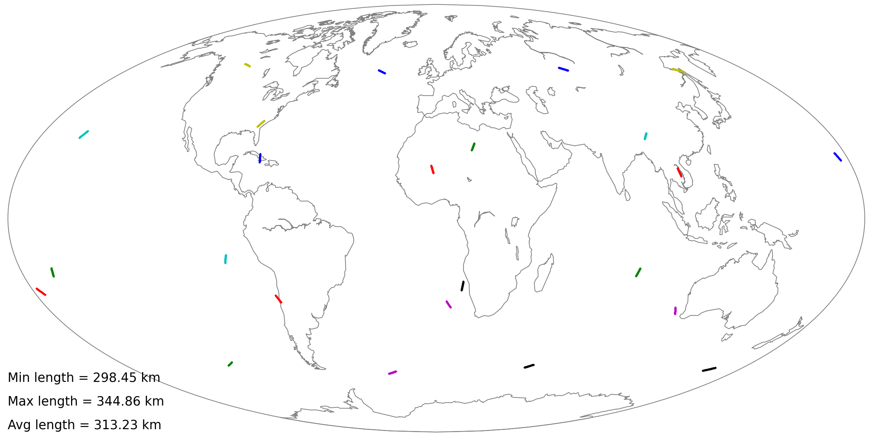
GPS and LEO in same plane
Each streak on the map shows tangent point as a function of time for one occultation. Only one receiver and one GPS considered here.
This is close to the best case scenario (i.e., smallest streak length would occur if both the GPS and receiver satellites were in equatorial orbits).

Slide 35
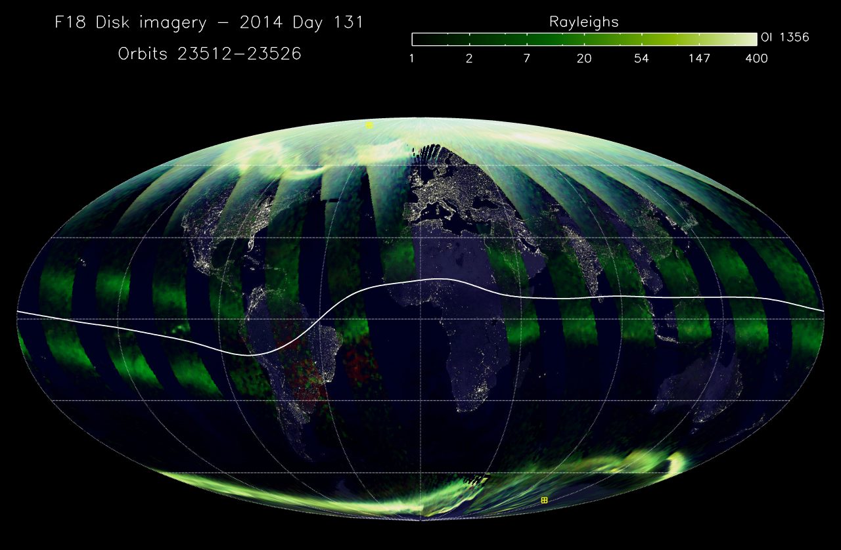
GPS and LEO with inclination offset of 45°

Slide 36
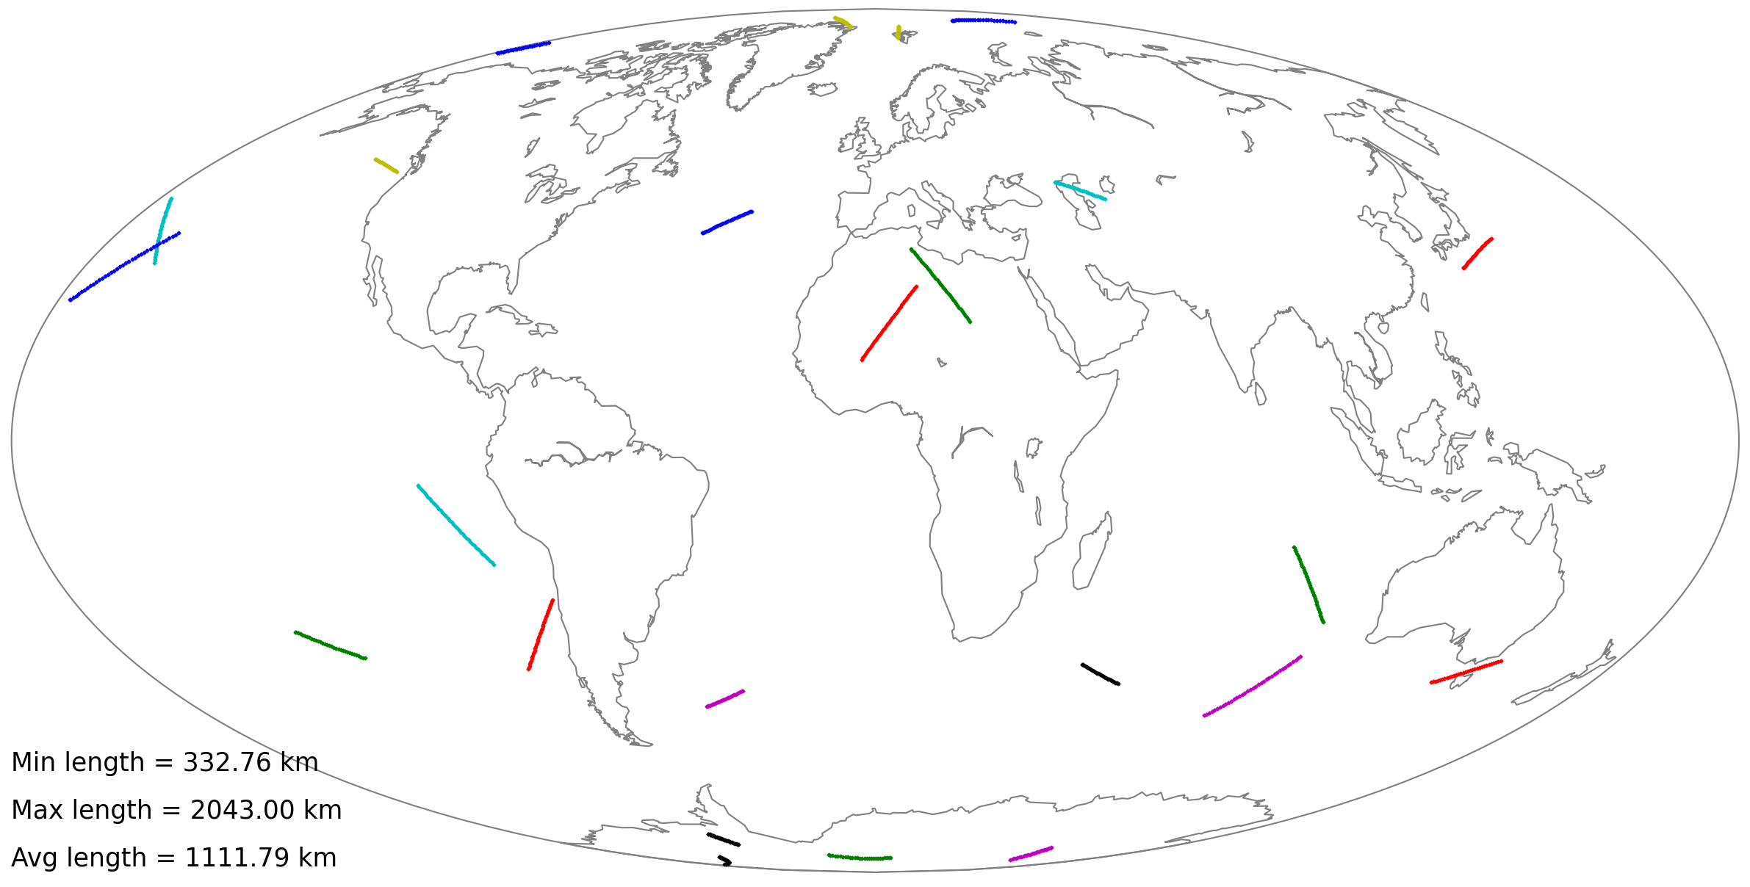
GPS and LEO with inclination offset of 45°

Slide 37
GPS and LEO with inclination offset of 45°

Slide 38
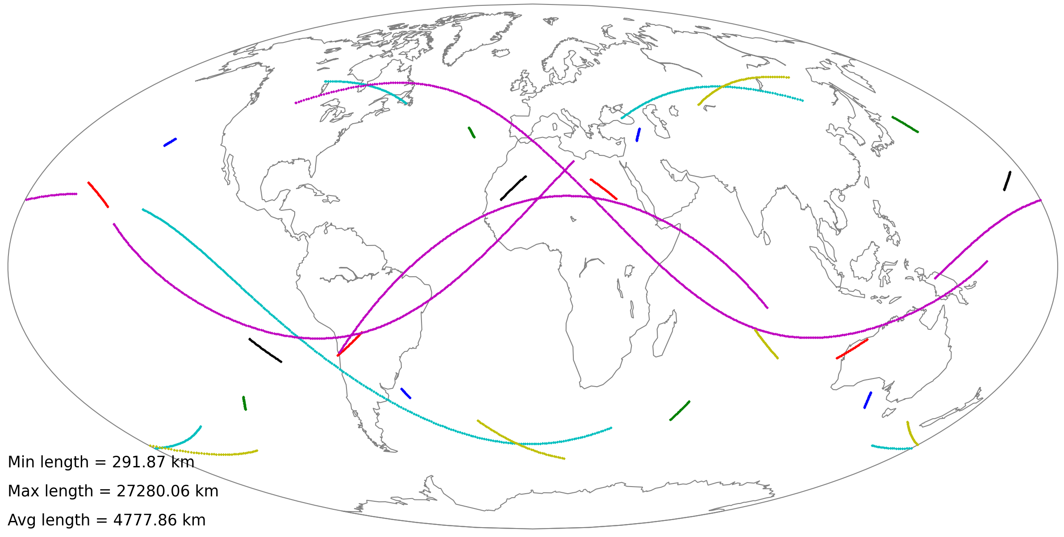
GPS and LEO with inclination offset of 90°
Most of the occultations from this geometry would need to be rejected.

Slide 40
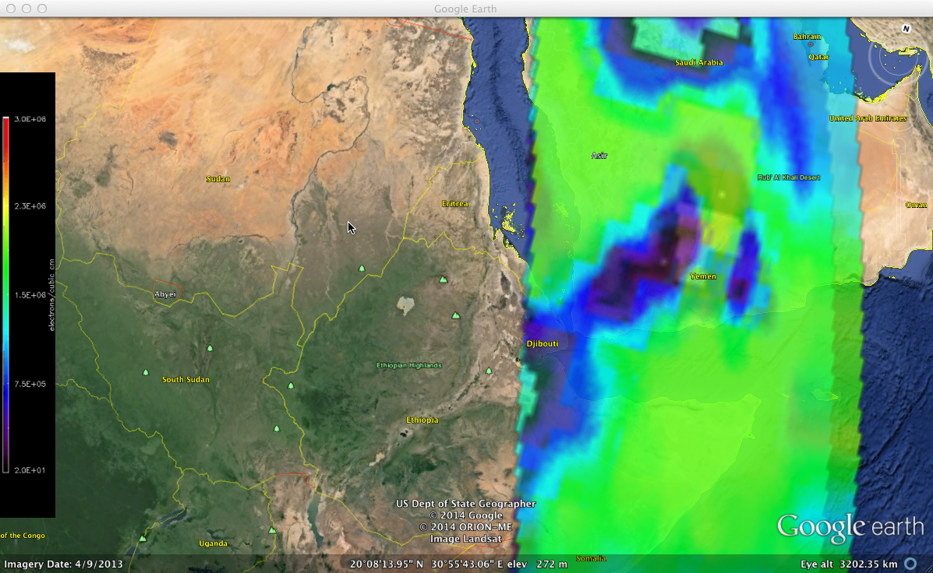
Zoom up on region of interest to exploit vulnerabilities or to perform TTL

Slide 41
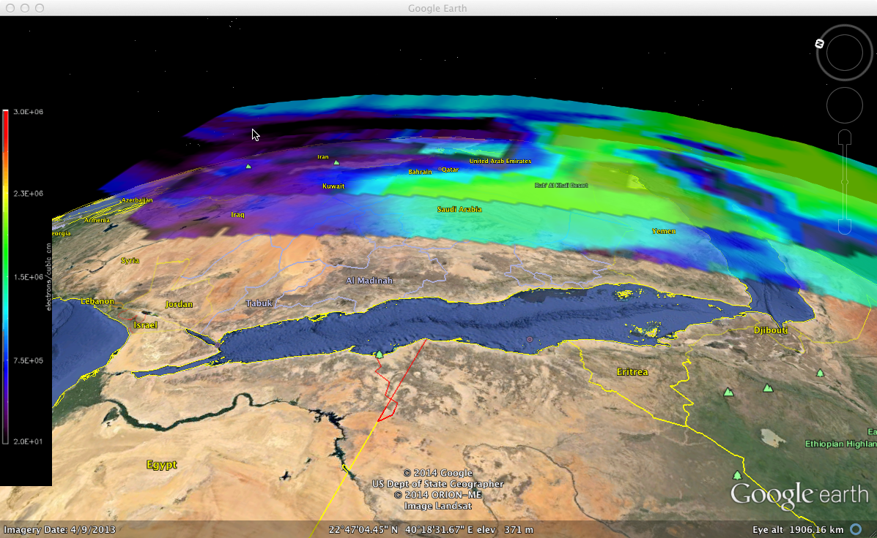
Vulnerability Assessment
Ray reflected by the ionosphere
Ray through the ionospheric hole

Slide 42
SSUSI can Enhance the Value of GPS RO
Minimum tangent point motion (“streak length”) is about 300 km.
Increases for increasing receiver inclination.
For one receiver and one satellite, have 24–30 occultations per day (~1 per hour)
For one receiver over all 32 GPS satellites, have ~800 occultation opportunities per day, but not all are viable measurements
SSUSI or SSUSI-Lite generates about 15,000 global profiles per orbit.
SSUSI generates 600,000 lines of sight measurements per orbit.
The orbit plane inclination offset gives us a useful opportunity.
  Co-manifesting SSUSI-Lite with GPS RO enables us to locate the fluxtube with the turbulence in it.
  GPS RO is also blind to depleted flux tubes that do NOT show turbulence/scintillation but that would still refract RF

Slide 43
Information Content of GPS RO can be Enhanced
Horizontal resolution is generally poor, especially given assumptions of atmospheric homogeneity
Tangent point geometry is complex: moves in latitude and longitude with time
Ionospheric occultations generally take 5-10 minutes to complete, up to an hour for extreme cases
  Tangent point moves significantly over this period of time
Small scale structures in ionosphere can be easily missed as seen in previous slides
  These results are typical and lead to the real danger of a bad forecast/nowcast
  GPS RO provides useful information in combination with SSUSI/SSUSI-Lite 3D cubes
  Topside sounder or SDR used to monitor scintillation would provide additional information.

Slide 44
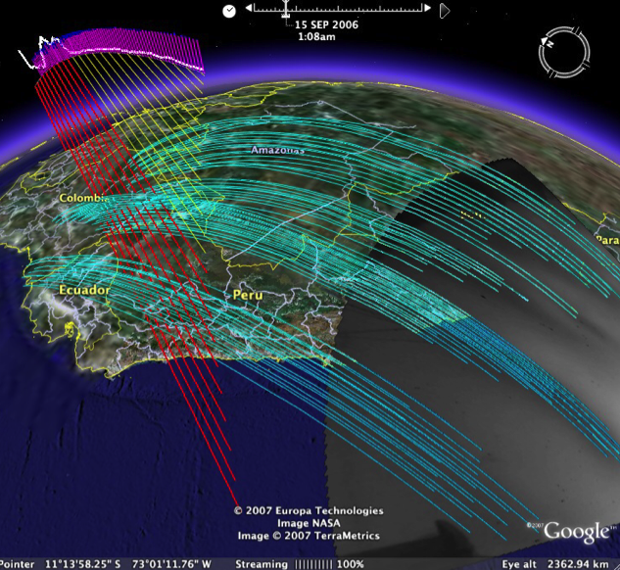
GPS RO and Depleted Flux Tubes – Location is sensitive to observational geometry without SSUSI
Line of sight may miss depleted flux tubes.
Attribution of changes in GPS signal to a depleted flux tube is difficult because a given flux tube is not sampled often.
Depleted flux tubes may or may not be turbulent or exhibit scintillation at GPS wavelengths.
SSUSI/SSUSI-Lite enables us to locate the depleted region.

Slide 45
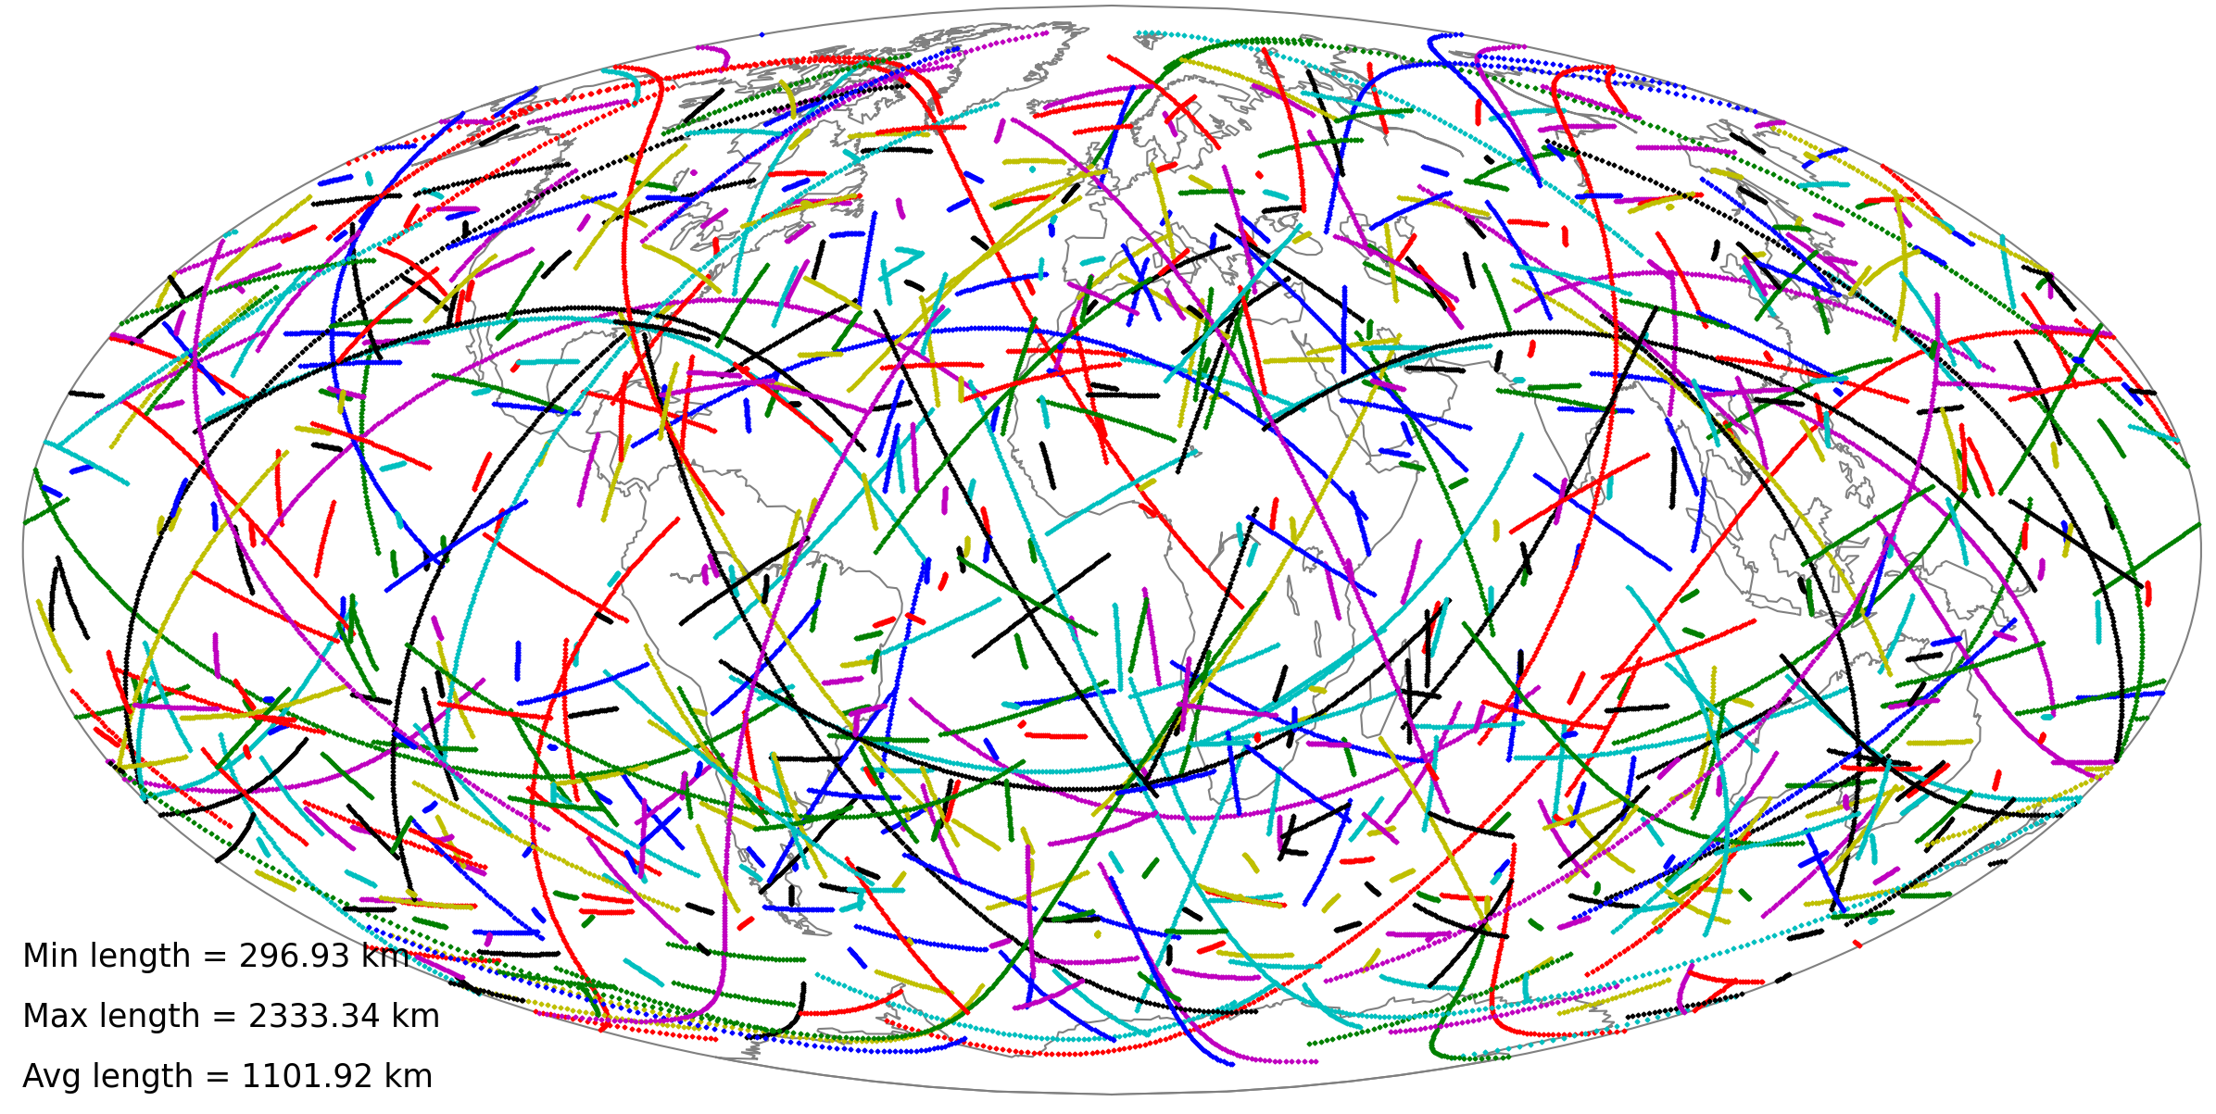
Coverage of GPS Soundings
Earlier plots indicate coverage from one receiver to one GPS
This plot shows possible coverage from one receiver to all 32 GPS satellites
Caveat: some occultations overlap, and would only be viable if multiple receivers available on a satellite
Bottom line: good coverage, except over the extreme polar regions

Slide 46
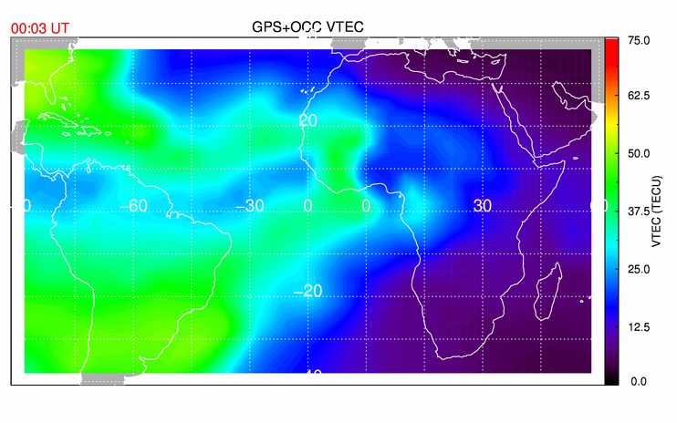
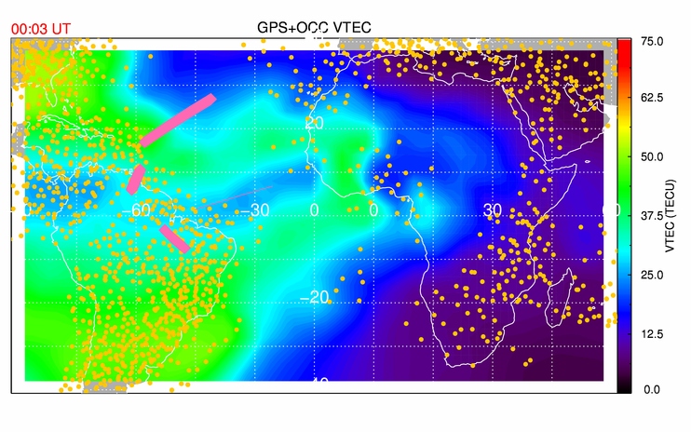
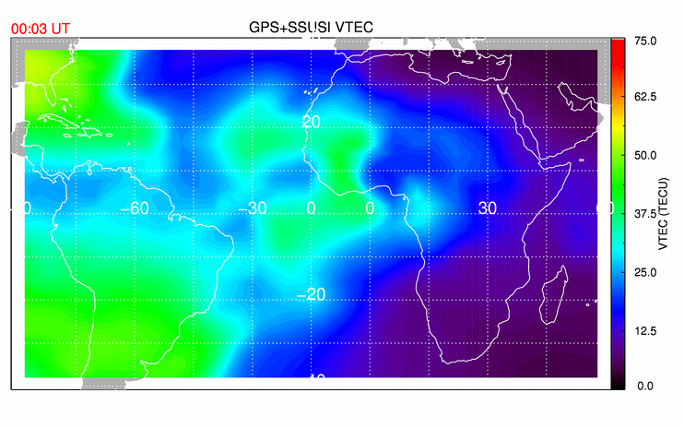
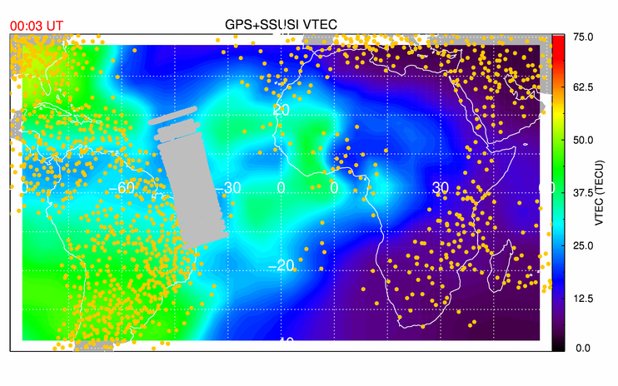
SSUSI-Lite provides high-resolution regional data that GPS-RO cannot
GPS TEC + GPS RO
Despite nearby occultations, the model is strongly biased by the prior (climatology).
GPS TEC + SSUSI

Slide 47
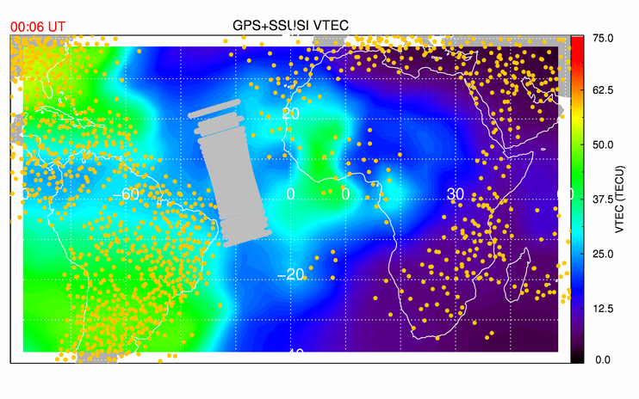
SSUSI-Lite “Corrects” Climatologies
SSUSI-Lite provides important data were there are no ground-based GPS
Observations are much more dense than GPS-RO
This is vital for theatre-scale operations, small-scale irregularities that cause scintillation.

Slide 48
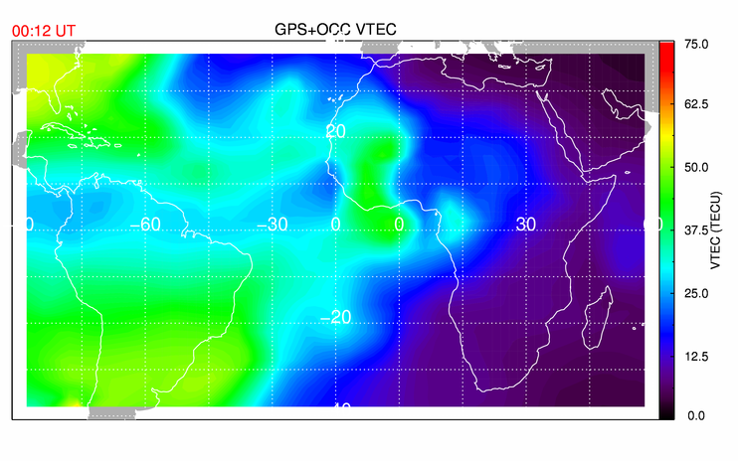
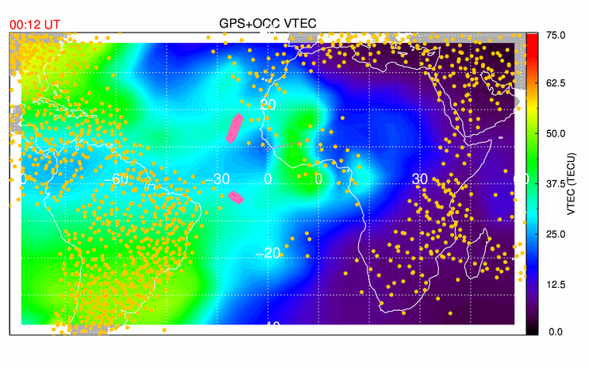
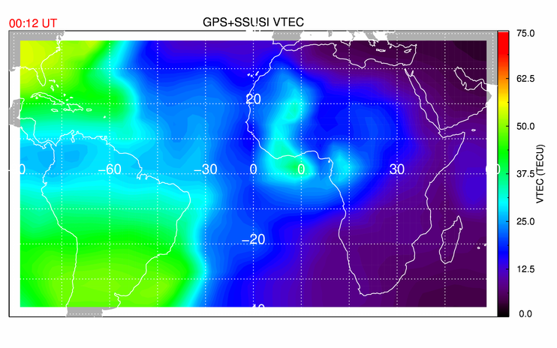
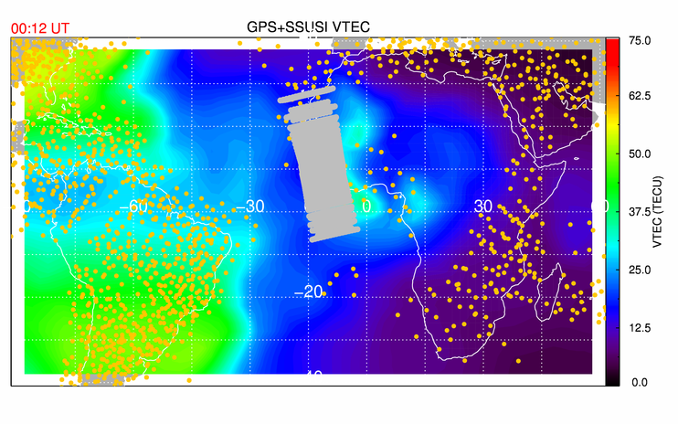
Calibration Occultations DO Help
GPS TEC + GPS RO
GPS TEC + SSUSI

Slide 49

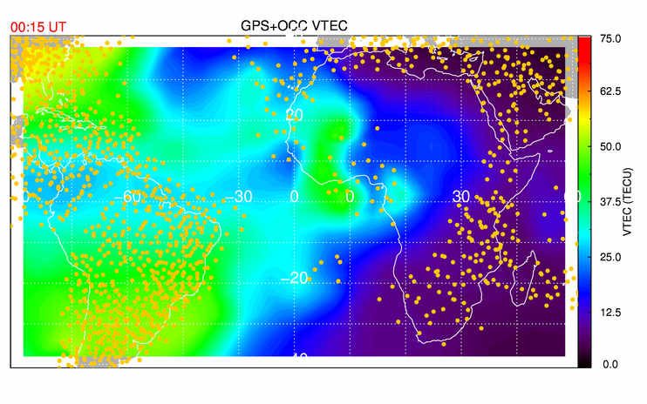
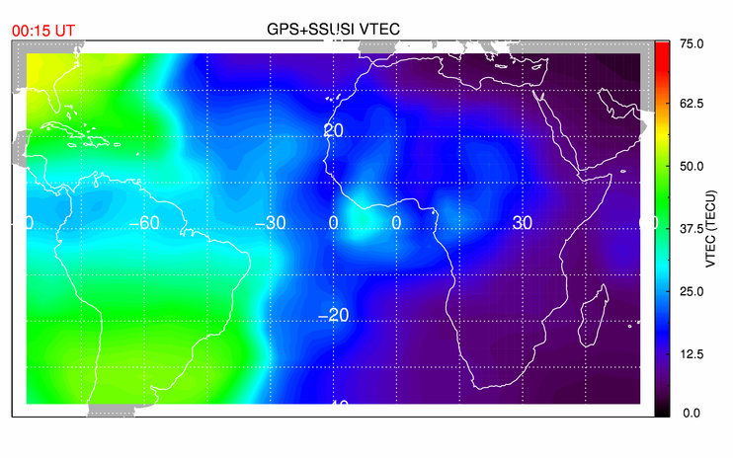
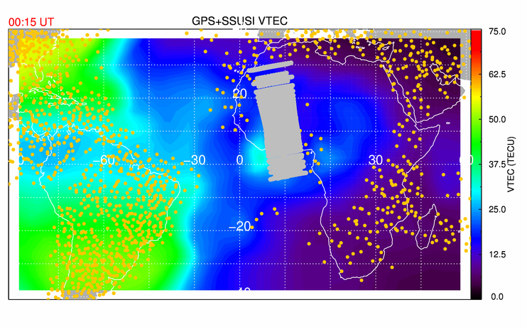
However – Suitable Occultations are not Always Available
GPS TEC + GPS RO
GPS TEC + SSUSI

Slide 50
Performance of Assimilative Model with SSUSI-Lite Data Demonstrates Value of SSUSI with GPS RO
Task: Assess impact of adding datasets to assimilative ionosphere model like GAIM
  Comparing IDA4D results with truth simulation
  Quantify impact of adding different instrument data sets to the model
Complete an OSSE (Observing System Simulation Experiment) with SSUSI and GPS-RO on same satellite
  OSSE provides a means to test the value proposition
OSSE consists of:
  A nature run (a model forecast as “true atmosphere”) closely reflecting the reality;
  Construction of existing observation datasets and
  new observations from the nature run;
  Introduction of errors (observations, representative errors) representing those in reality;
  Calibrations so that the existing observation impact in real and simulated atmospheres is similar based the forecast model and data assimilation technique

Slide 51
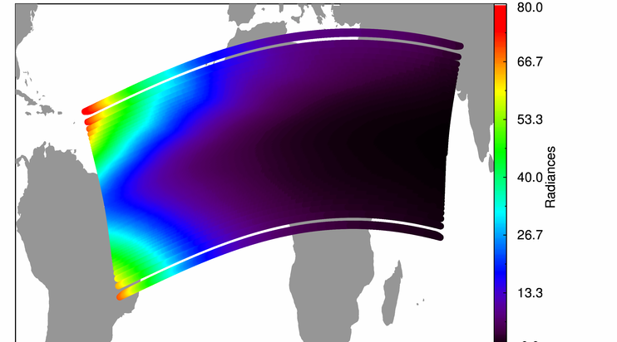
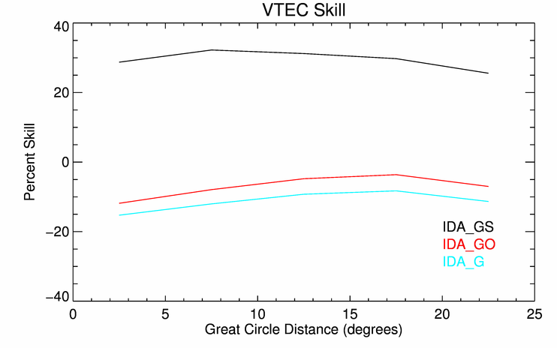
Task 6 OSSE Configuration/Concept was Rigorous
Instrument forward models
Simulated observations of simulated ionosphere
Ingest observations into assimilative model (IDA4D)
Compare assimilation to simulated “truth” ionosphere
Simulated “truth” ionosphere model (from TIEGCM)

Slide 52
We Determined a Skill Score for the Addition of SSUSI-Lite Data
The purpose of a skill score is to quantify the performance improvements of the analysis over a baseline model
It can be used to quantify the impact of new data sets on the analysis
It can be used to quantify the impact of new algorithm methods on the analysis
It can be used to quantify performance improvement of the analysis over time
A skill score approaching 1 (100%) implies the analysis is reproducing the truth almost exactly.
A skill score ~ 0 implies no improvement over the model
A skill score < 0 implies the analysis is worse than the model

Slide 53
Skill score evaluation shows SSUSI-Lite Improvement
SSUSI-Lite produces a MAJOR positive skill improvement on IDA4D assimilations versus truth---that is, SSUSI-Lite makes the assimilation more like the “truth” model.
Straight GPS-TEC and GPS-RO make the data assimilation worse (farther from truth).
GAIM comparisons would not show this as strongly because of the low resolution.

Slide 54
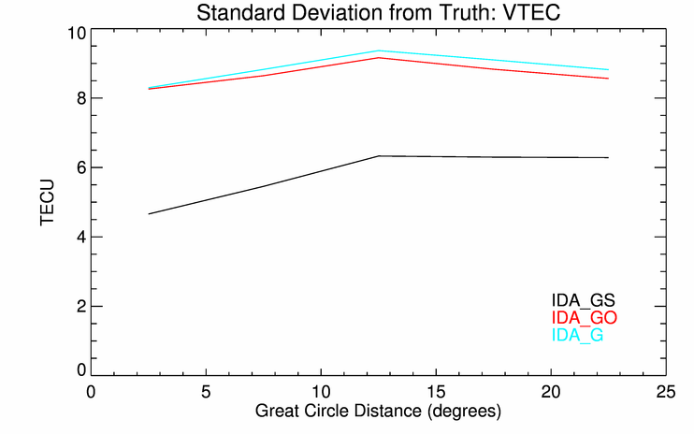
VTEC Standard Deviations are Better with SSUSI-Lite than with GPS RO
Addition of one SSUSI-Lite instrument makes a considerable improvement in the forecast over adding one GPS-RO instrument.
We note that adding SSUSI-Lite to some GPS RO flights has considerable value beyond VTEC
  VTEC is the “usual” litmus test of value but is not appropriate for most customers

Slide 55
We have developed the next generation SSUSI instrument with all the capability (and more) at less than half the mass and half the power.
Contact us for details

